Slide 1
CS 4476/7646 Project 2
Sreyans Sipani
ssipani6@gatech.edu
903310164

Slide 2
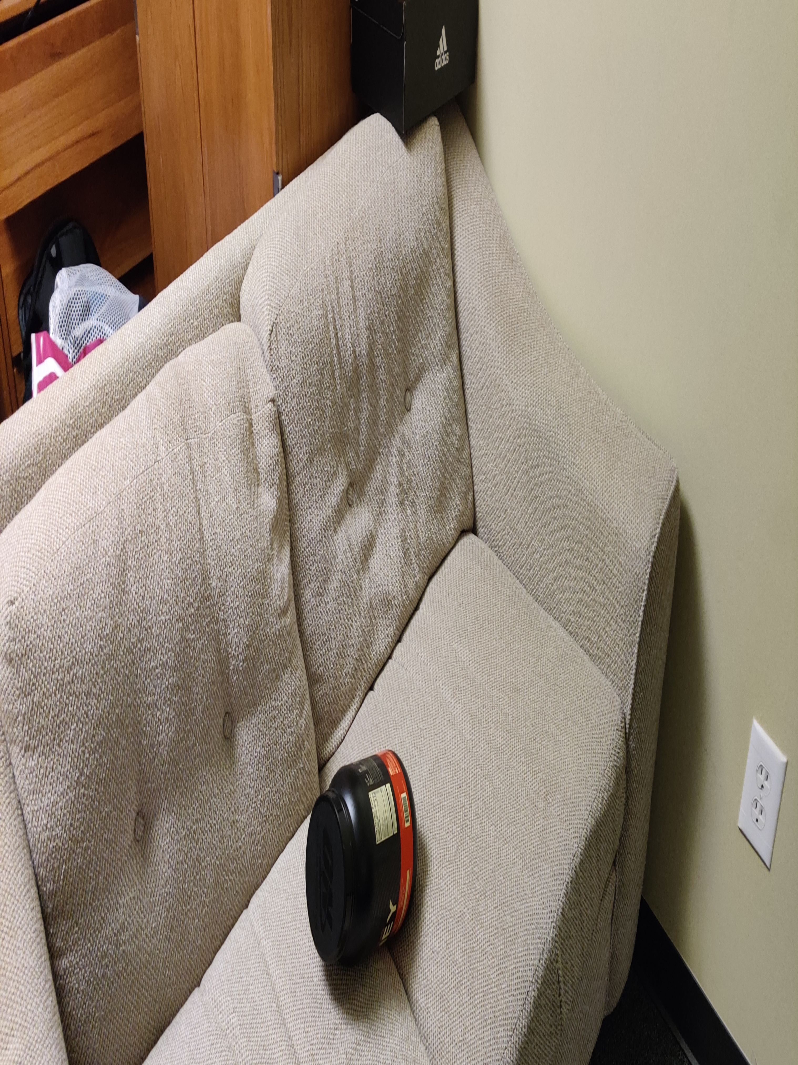
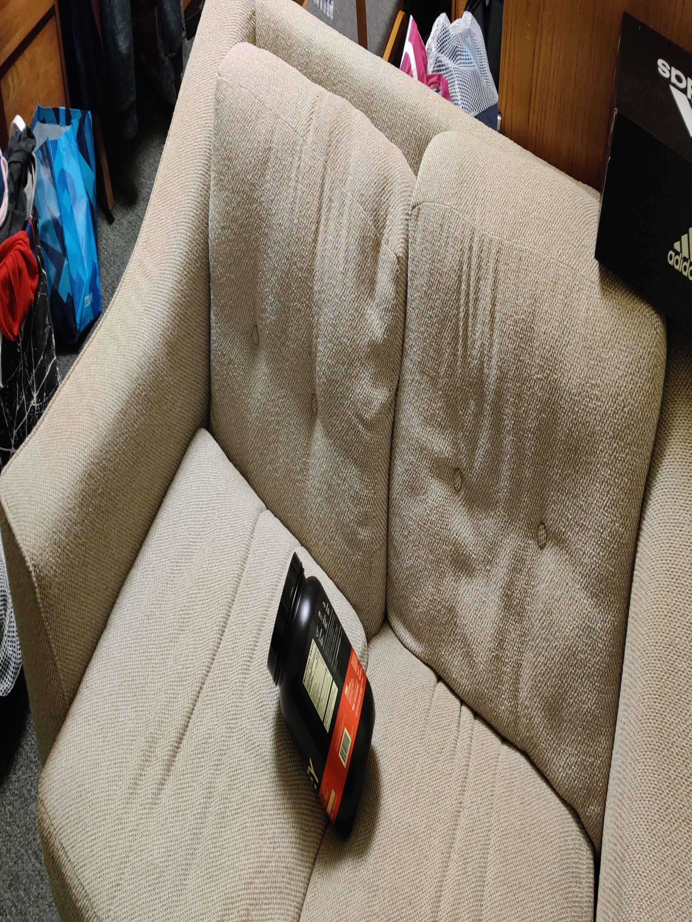
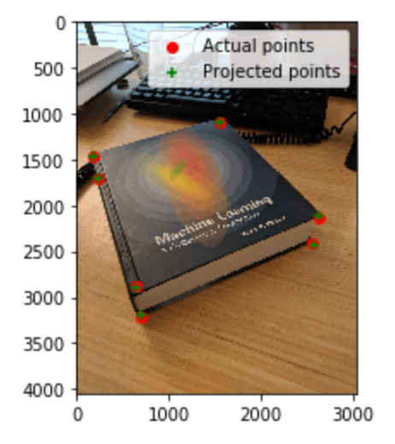
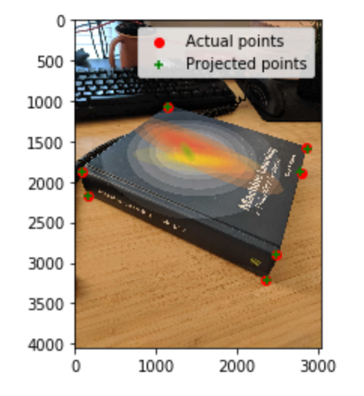
Part 1: Projection Matrix
<insert visualization of projected 3D points and actual 2D points for image provided by us here>
< insert the two images of your fiducial object here>

Slide 3
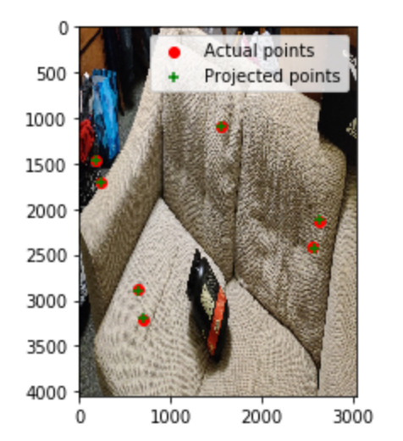
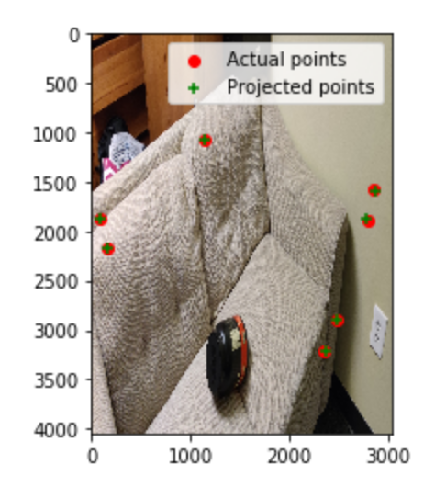
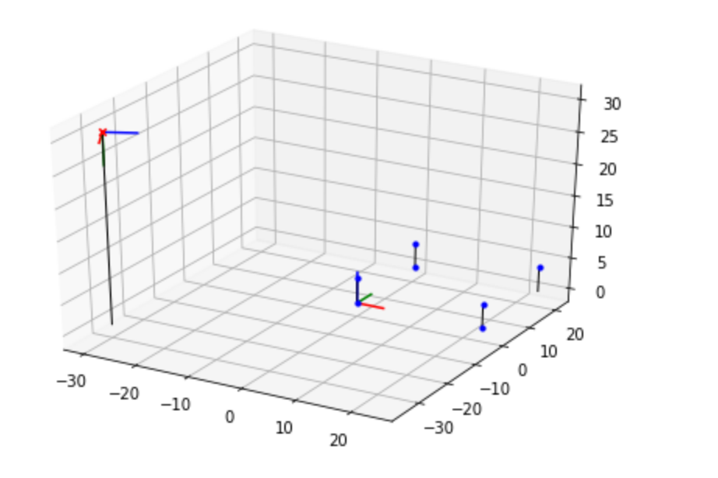
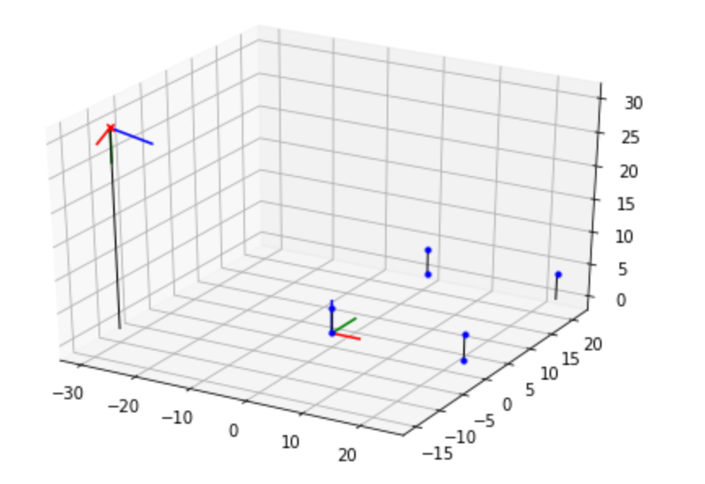
Part 1: Projection Matrix
<insert visualization the initial guesses for rotation matrix and camera center for the two images here>
<insert visualization of projected 3D points and actual 2D points for both the images you took>

Slide 4
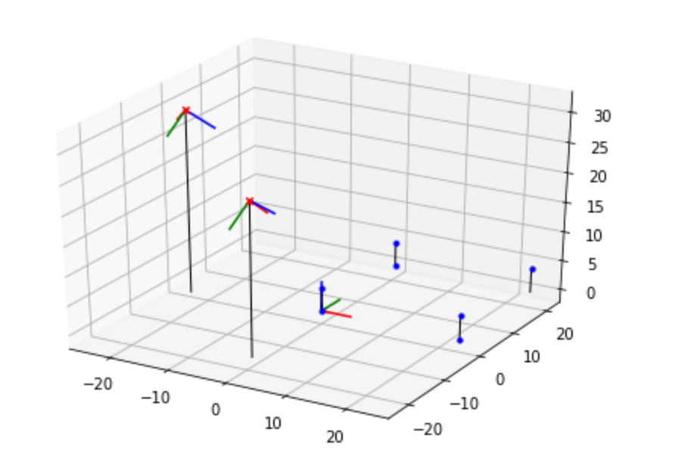
Part 1: Projection Matrix
<insert visualization of both camera poses here>

Slide 5
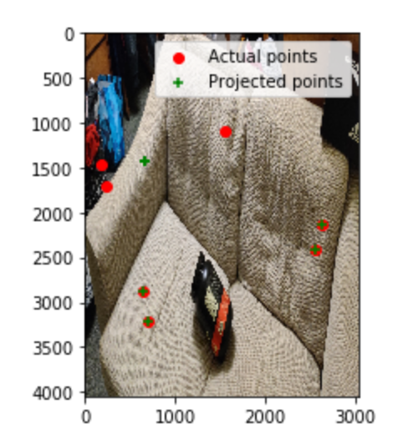
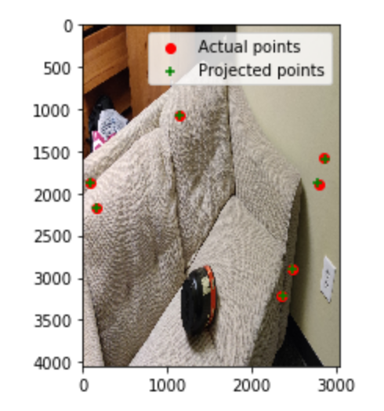
Part 1: Projection Matrix
I would expect the projections to be the same as the projection matrix doesn’t depend on the camera center. As we notice most projections are still correct except a few.

Slide 6
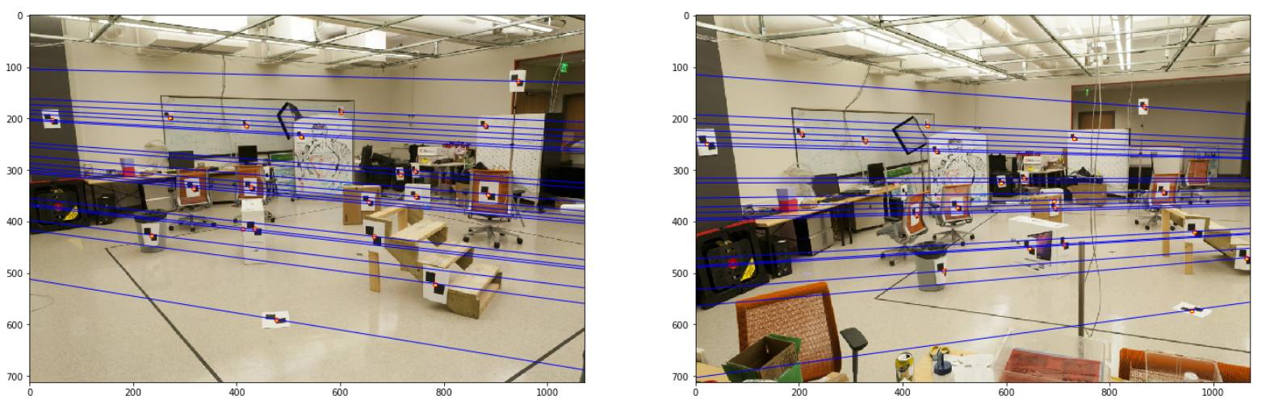
Part 2: Fundamental Matrix Estimation
Room: Left Image with Epipolar Lines
Room: Right Image with Epipolar Lines

Slide 7
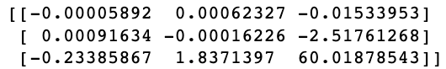
Part 2: Fundamental Matrix Estimation
Fundamental Matrix Estimation Result:

Slide 8
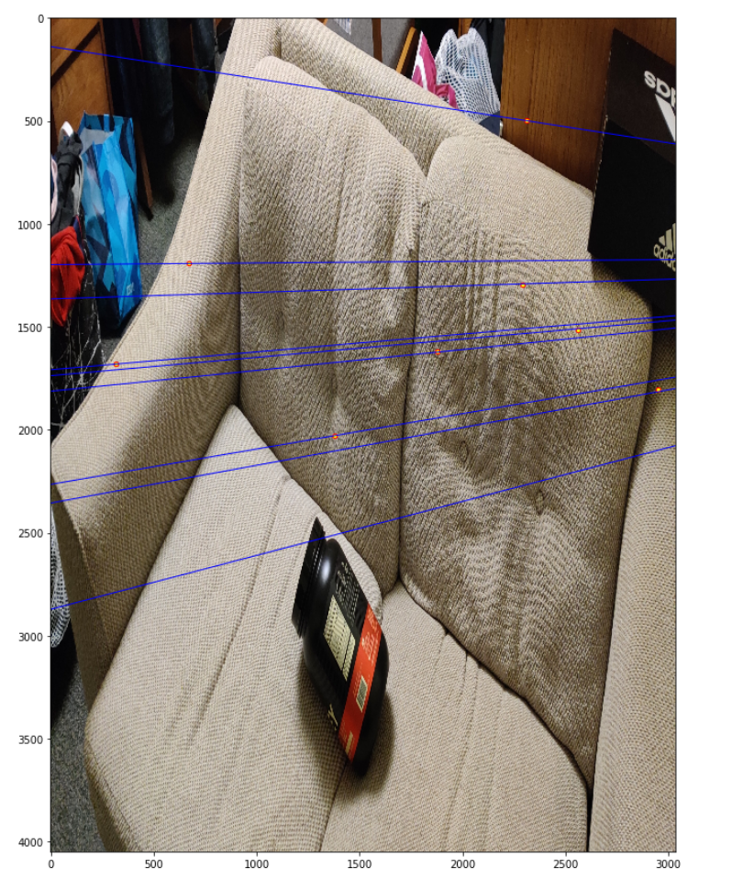
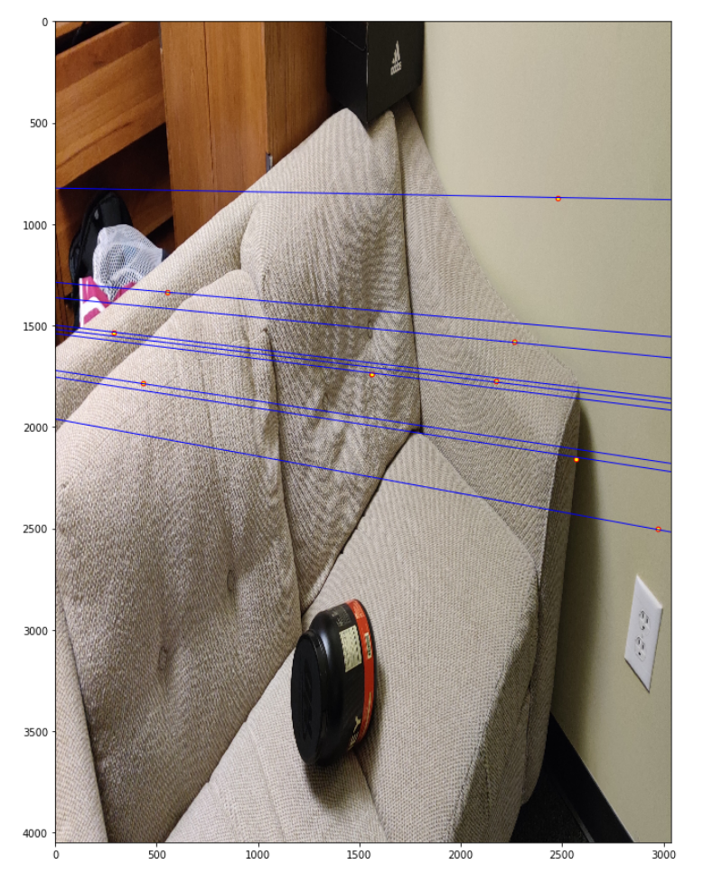
Part 2: Fundamental Matrix Estimation: Your Images
Your Image: Left Image with Epipolar Lines
Your Image: Right Image with Epipolar Lines

Slide 9
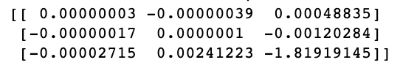
Part 2: Fundamental Matrix Estimation: Your Image
Fundamental Matrix Estimation Result:

Slide 10
Part 2: Reflection Questions
1. The principal point and the focal length should be the same
2. The correspondences selected to estimate the fundamental matrix are such that they are restricted to epipolar lines and therefore the relation which the fundamental matrix represents is the epipolar constraint.
3. The epipoles become the camera centres themselves and the epipolar lines are reduced to those points.
4. The images are parallel
5. The equation used to define the fundamental matrix is – x’Fx = 0. kF is also a solution to this equation for any k
6. As the epipoles lie on the epipolar lines themselves, eF = 0 for both epipoles e. Therefore the nullspace of F is not equal to the zero vector and it is rank deficient. As F is 3x3, its rank=2.

Slide 11
Part 2: Extra Credit: Fundamental Matrix Song
Reflect on the Fundamental Matrix Song
Link here: https://www.youtube.com/watch?v=DgGV3l82NTk
The sample set will be degenerate if we use coplanar scenes and therefore if we have three scenes, we can use the trifocal sensor. He also used the bow tip at different instances to create the fundamental matrix.

Slide 12
Part 3: RANSAC Iterations Questions
Delete the questions and type your answers to the three RANSAC Iterations questions from the jupyter notebook below:
15
43 – Exponential Increase
168

Slide 13
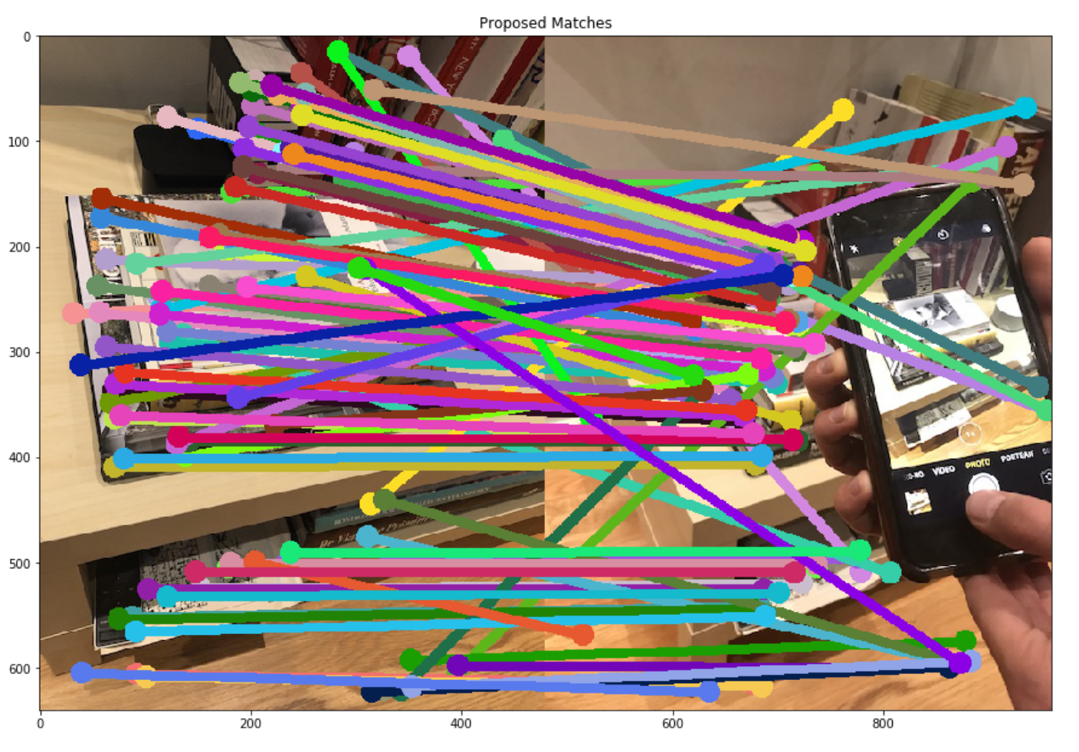
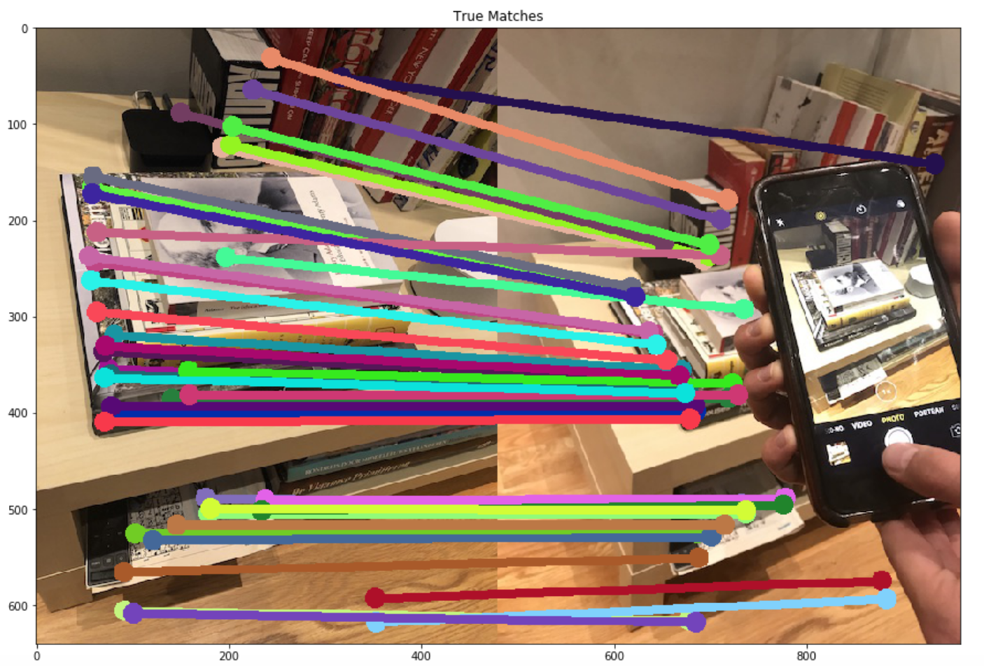
Part 3: RANSAC Inlier Matches
Paste two sets of images: displaying matches loaded from disk; and inlier matches after RANSAC

Slide 14
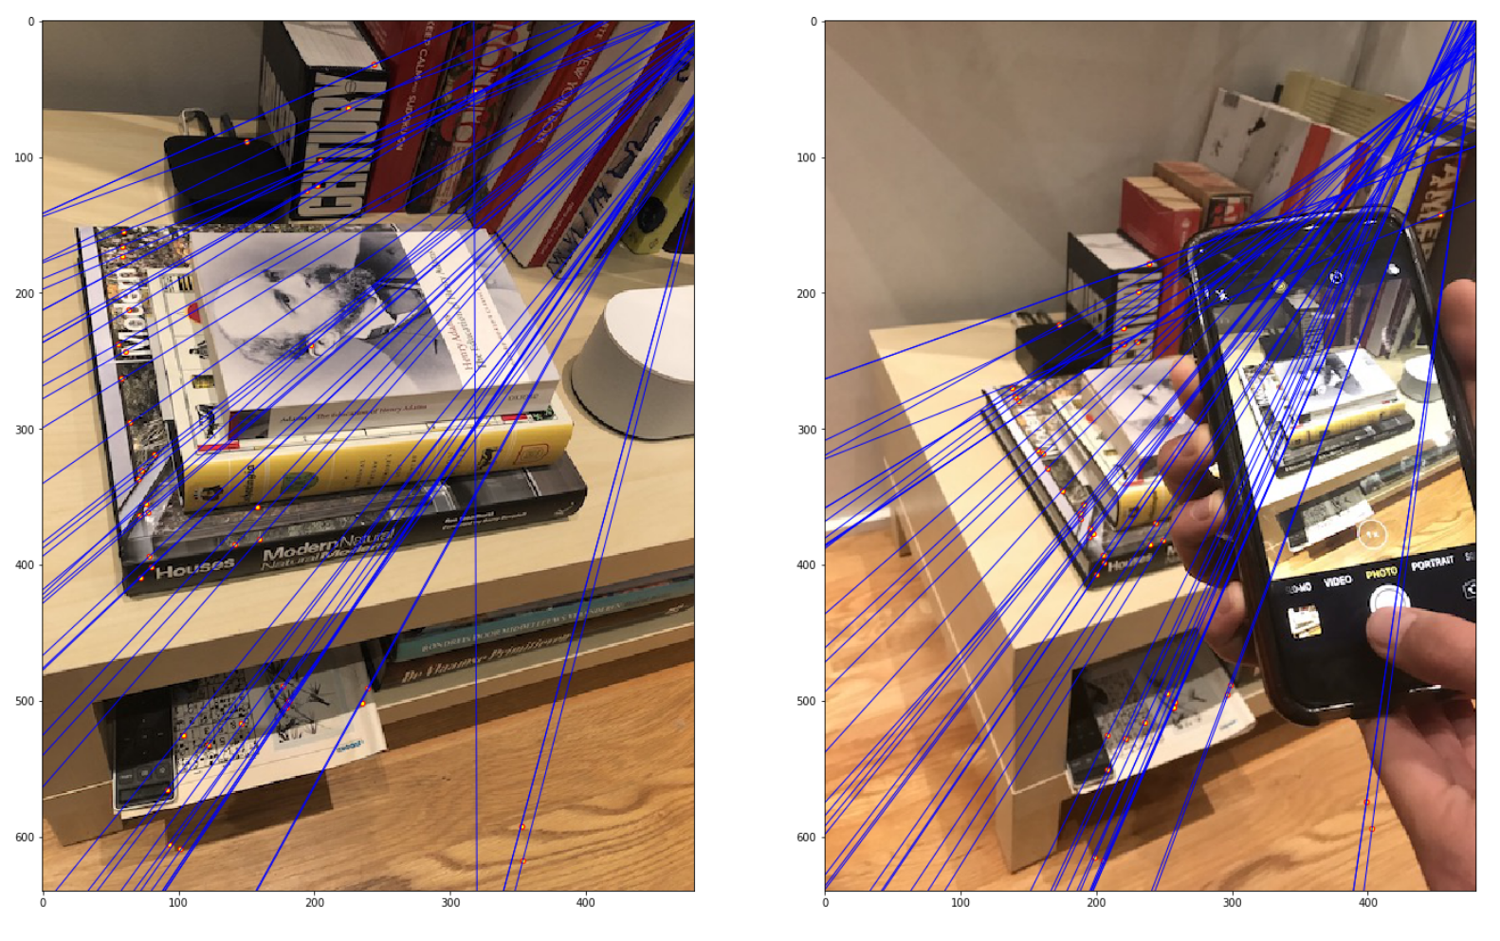
Part 3: RANSAC Implementation

Slide 15
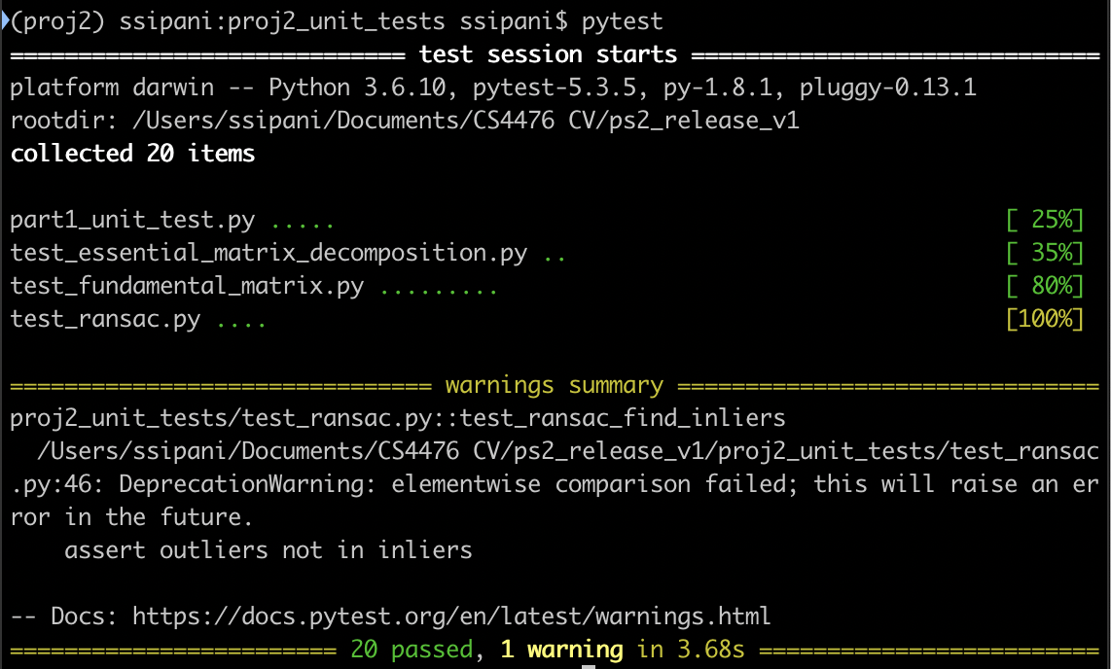
Tests

Slide 16
Conclusions
Image scaling was a problem which I encountered and understood how it could cause problems. While solving part 4, one sees that the SVD does not yield accurate results due to real world data due to which I read about how we have to consider possible solutions and algorithms to bypass it.
Overall I learned how manipulate images and perform linear algebra operations in python.

